Slide 1
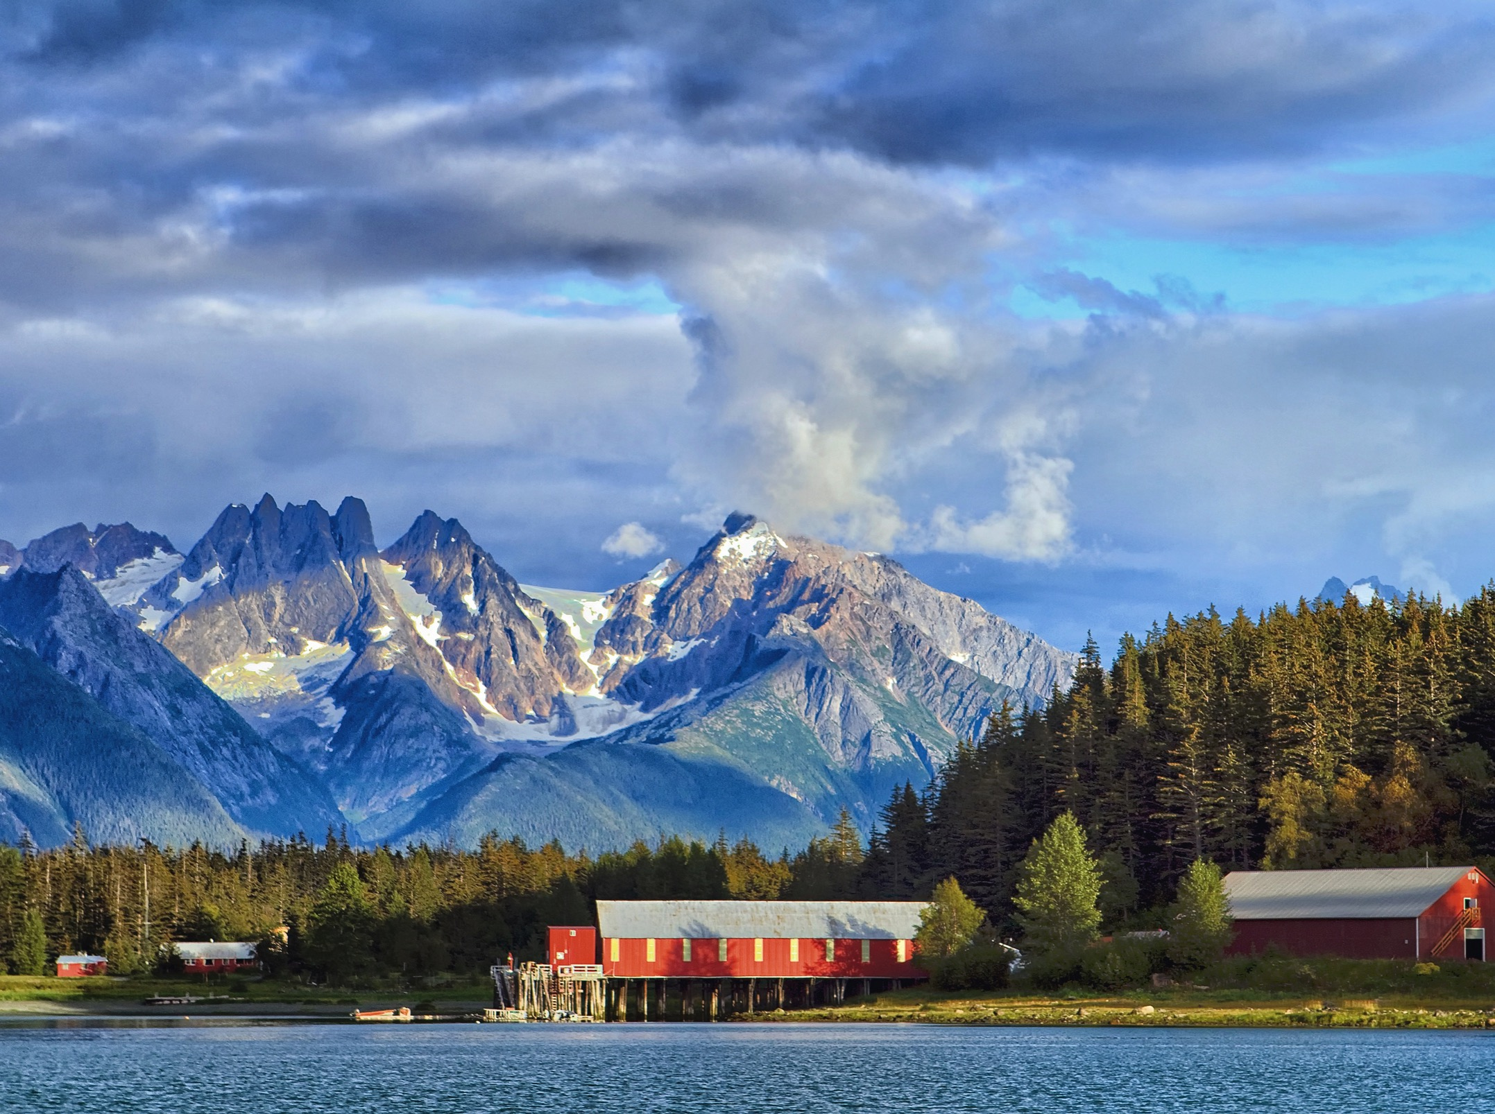
Economic Resiliency in Sitka and Southeast Alaska
Southeast
Conference
Presented to
Sitka
Economic
Development
Association
April 22, 2021

Slide 2
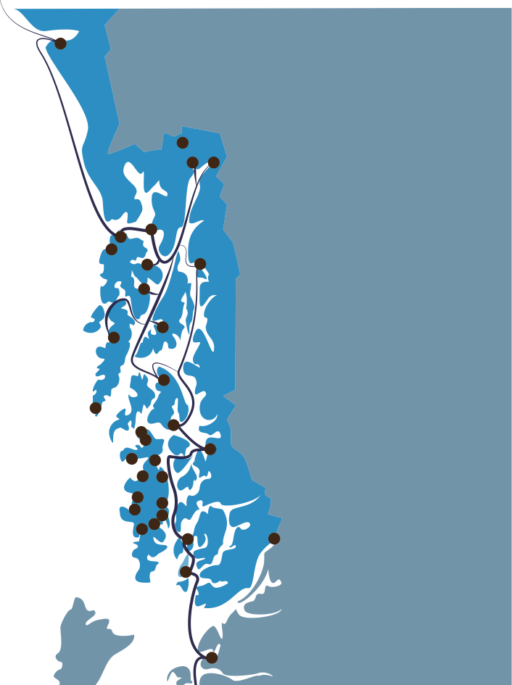
About Southeast Conference
Southeast Conference was incorporated in 1958, primarily to advocate for the creation of the Alaska Marine Highway System.
After that success, stayed together to continue to advocate for issues that are key to the southeast region as a whole.
Looks for consensus for the betterment of the region.
Members from nearly every community, chamber of commerce, and economic development organization in the region.
Support the Southeast Conference of Mayors and the Marine Transportation Advisory Board.
Southeast Conference is the federally designated Regional Economic Development District and the State-designated Alaska Regional Development Organization.

Slide 3
About Southeast Alaska
34 Communities
1,000+ Islands
500 Miles
18,500 shoreline
10% of AK Economy

Slide 4
Transportation
Energy
Maritime
Promoting strong economies, healthy communities, and a quality environment in Southeast Alaska.
Mining
Visitors
Seafood
Timber
Visitors
Notes:
This is our mission at Southeast Conference. Our key areas of focus include economic development, transportation, energy, maritime, seafood, tourism, timber, and mining.

Slide 5
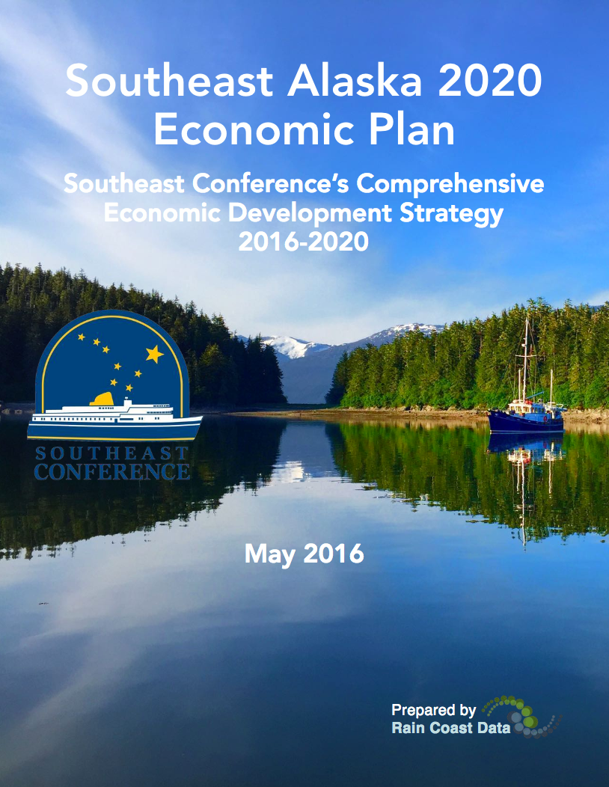
National Association of Development Organizations
Plan is winner of the 2018 NADO Innovation Award
“The region’s current CEDS Southeast Alaska 2020 is one of the best examples in the country…”
Notes:
Award for creative approaches to advancing community and economic development and improved quality of life while making significant impacts on their regions and demonstrate the diversity of services and program delivery provided.

Slide 6
Southeast Alaska Resiliency Mapping
Surviving the Pandemic Economy
Results of Mid Session Summit Planning Exercises

Slide 7
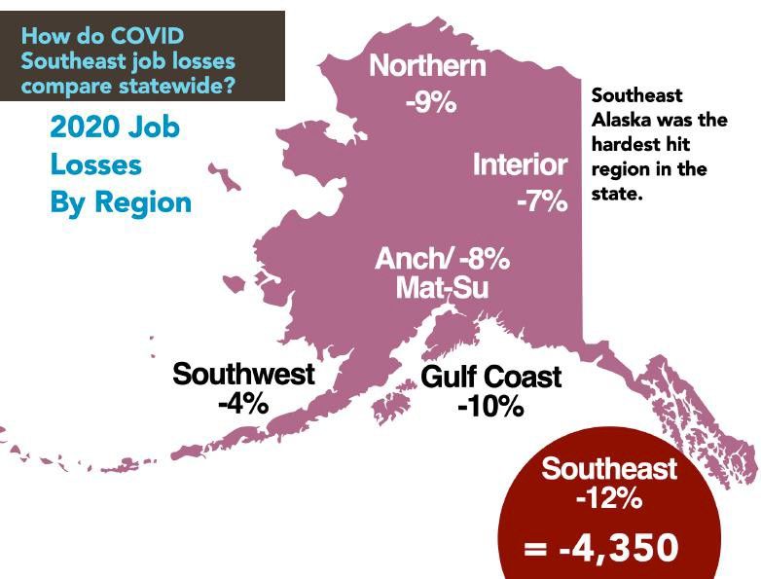
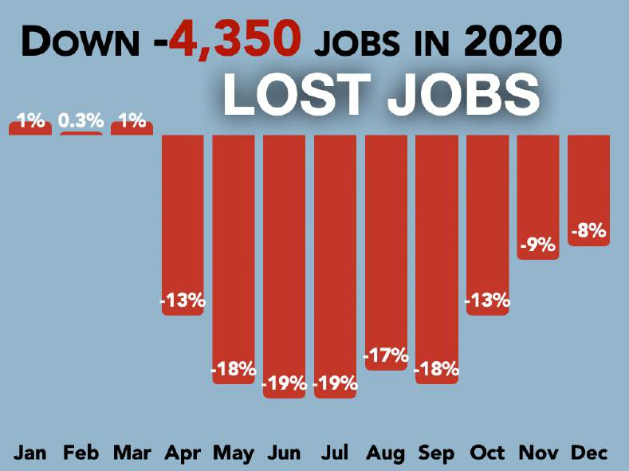
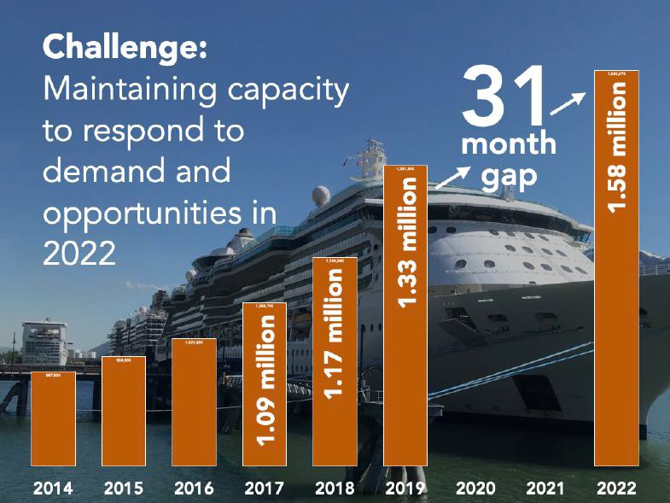

Slide 8
140
Rate your level of concern regarding how the COVID-19 crisis will continue to impact your:
Significantly concerned
Maximum concern
48%
40%
88%
Region
36%
41%
Community
78%
35%
28%
Business
62%
24%
32%
Industry
56%
0%
25% 50%
75%
100%

Slide 9
What Business Leaders Are Doing to Survive until 2022
Moving forward, what actions, initiatives, changes are you planning to implement to ensure the economic resilience of your business or industry until 2022?

Slide 10
₁ Revenue
What Business Leaders Are Doing to Survive until 2022
Diversification
Find new clients, develop new
products, expand markets
₂ Vaccination Advocacy
Distribute vaccines, explain importance of vaccinations

Slide 11
3 Spending, Staff &
What Business Leaders Are Doing to
Survive until 2022
Service Reductions
Cut costs, reduce budgets,
downsize staff, freeze hiring
₄ Maximizing Federal Benefits
Take advantage of federal stimulus funding to replace income and keep businesses operating

Slide 12
What Business Leaders Are Doing to Survive until 2022
5 Encouraging local spending and hiring
6 Engaging in long-term economic planning
7 Applying for grants, loans, debt relief,
debt deferment
8 Moving business and staff online

Slide 13
What Business Leaders Are Doing to Survive until 2022
9 Maintaining staffing levels
10 Survival mode until 2022
11 Advocacy for Passenger Vessel Services Act of 1886 waiver
Increased workforce training
Continued use of masks & testing

Slide 14
Getting to 2022: Short-Term Southeast Alaska
Resilience Plan Prioritization
140
1 Support Expedited Vaccine Distribution
2 Revitalization of Air, Ferry, Cruise, and Freight Transportation Services
71%
67%
3 Plan to Regrow the Visitor Industry Post-Pandemic
50%
₄ Economic Disaster Declaration Request
5 Plan for a post COVID-19 Southeast Alaska Health Care System
49%
34%
40%
80%

Slide 15
Getting to 2022: Short-Term Southeast Alaska Resilience Plan Prioritization
6 Work to Ensure Short-term Viability of the Seafood Sector
7Keep Southeast Alaskans in their Homes
33%
27%
8 Advocate for Childcare
9 Support Expedited Resolution to Solid Waste Shipping
10 Request Tariff Relief
20%
7%
3%
20% 40%

Slide 16
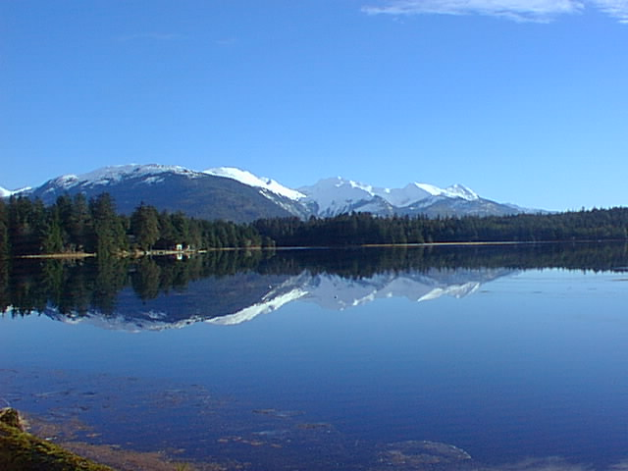
Comprehensive Economic Development Strategy (CEDS) Initiatives
Southeast Conference worked with municipal, tribal, business, and community leaders across Southeast Alaska to build the 20205 Economic Plan. The work was conducted through Southeast Conference’s extensive committee structure, including the seafood/maritime, tourism, transportation, energy, mining, timber, health care, economic development, and solid waste committees. The result is a comprehensive list of 59 prioritized economic initiatives, including four priority objectives that will constitute the focus of the Southeast Conference workplan over the next five years.

Slide 17
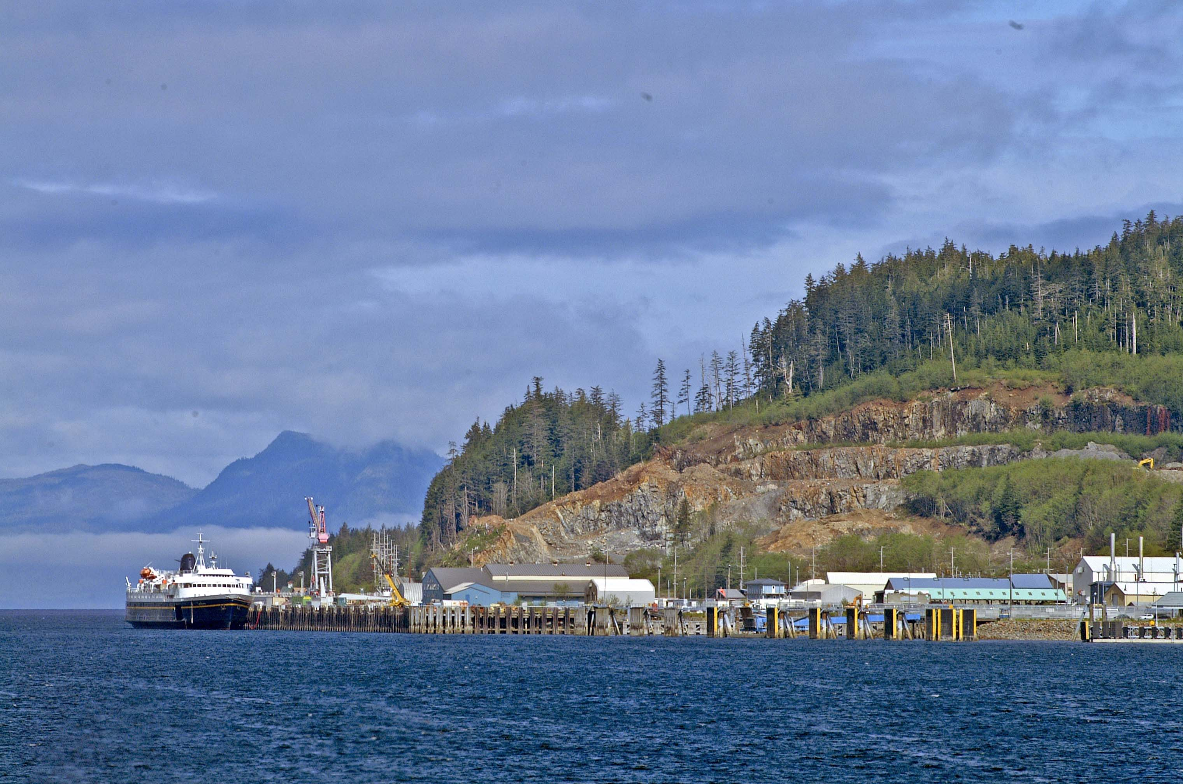
2025 CEDS Priority Initiatives
Transportation: Sustain and support the Alaska Marine Highway System
Seafood: Mariculture development
Visitor’s Industry: Market Southeast Alaska to attract more visitor spending and opportunities.
Energy: Promote Beneficial Electrification

Slide 18
EDA’s Investment priorities are:
Equity
Recovery & Resilience
Workforce Development
Manufacturing
Technology-Based Economic Development
Environmentally-Sustainable Development
Exports & FDI
EDA plays a vital role in advancing the mission of the Commerce Department by supporting community-led economic development strategies designed to create the conditions for economic growth and opportunity. These updated investment priorities will allow us to focus our efforts to ensure that American communities are in position to remain competitive on the global stage.
For more information, please visit: www.eda.gov

Slide 19
Available Relief Resources
There are many financial resources and programs available to Alaskans through the Small Business Administration. Most recently, the SBA Announced the release of Official restaurant revitalization fund
Providing $28.6 billion in economic relief prioritized for underserved communities. The SBA will administer funs to the hardest hit small restaurants.
Additionally, The SBA connects business owners with partner lending organizations, investors, disaster assistance, surety bonds, and grants. In addition to the SBA, there are other organizations and programs offering financial assistance in the form of loans and grants.
The Biden Administration created a list of infrastructure needs in Alaska as part of their state-by-state list of national needs as they build the case for passage of the American Jobs Plan legislation, allocating money for:
WORKFORCE DEVELOPMENT MANUFACTURING AND SMALL BUSINESSES
HOME HEALTH WORKERS
PUBLIC SCHOOLS AND COMMUNITY COLLEGES
PUBLIC HOUSING CLEAN ENERGY
BROADBAND
WATER SYSTEMS
TRANSPORTATION AND RESILIENCE Southeast Conference is working within the region to ensure that every dollar possible heads our way. If you have a project that fits in one of these categories - and the Southeast Comprehensive Economic Development Strategy, let us know.
Additional relief provided for the nation’s small businesses and hard-hit including:
$7.25 billion additional for the Paycheck Protection Program, including to expand eligibility to additional nonprofits and digital news services
Shuttered Venue Operators Grant program, and now allows businesses to apply for both a PPP loan after Dec. 27, 2020, and the SVOG
$15 billion additional for Targeted Economic Injury Disaster Loan Advance (EIDL) payments, including NEW $5 billion for Supplemental Targeted EIDL Advance payments for those hardest hit
$28.6 billion for the Restaurant Revitalization Fund for industry-focused grants
$100 million to establish a Community Navigator pilot program; grants will go to eligible organizations supporting efforts to improve access to COVID–19 pandemic assistance programs and resources.

Slide 20
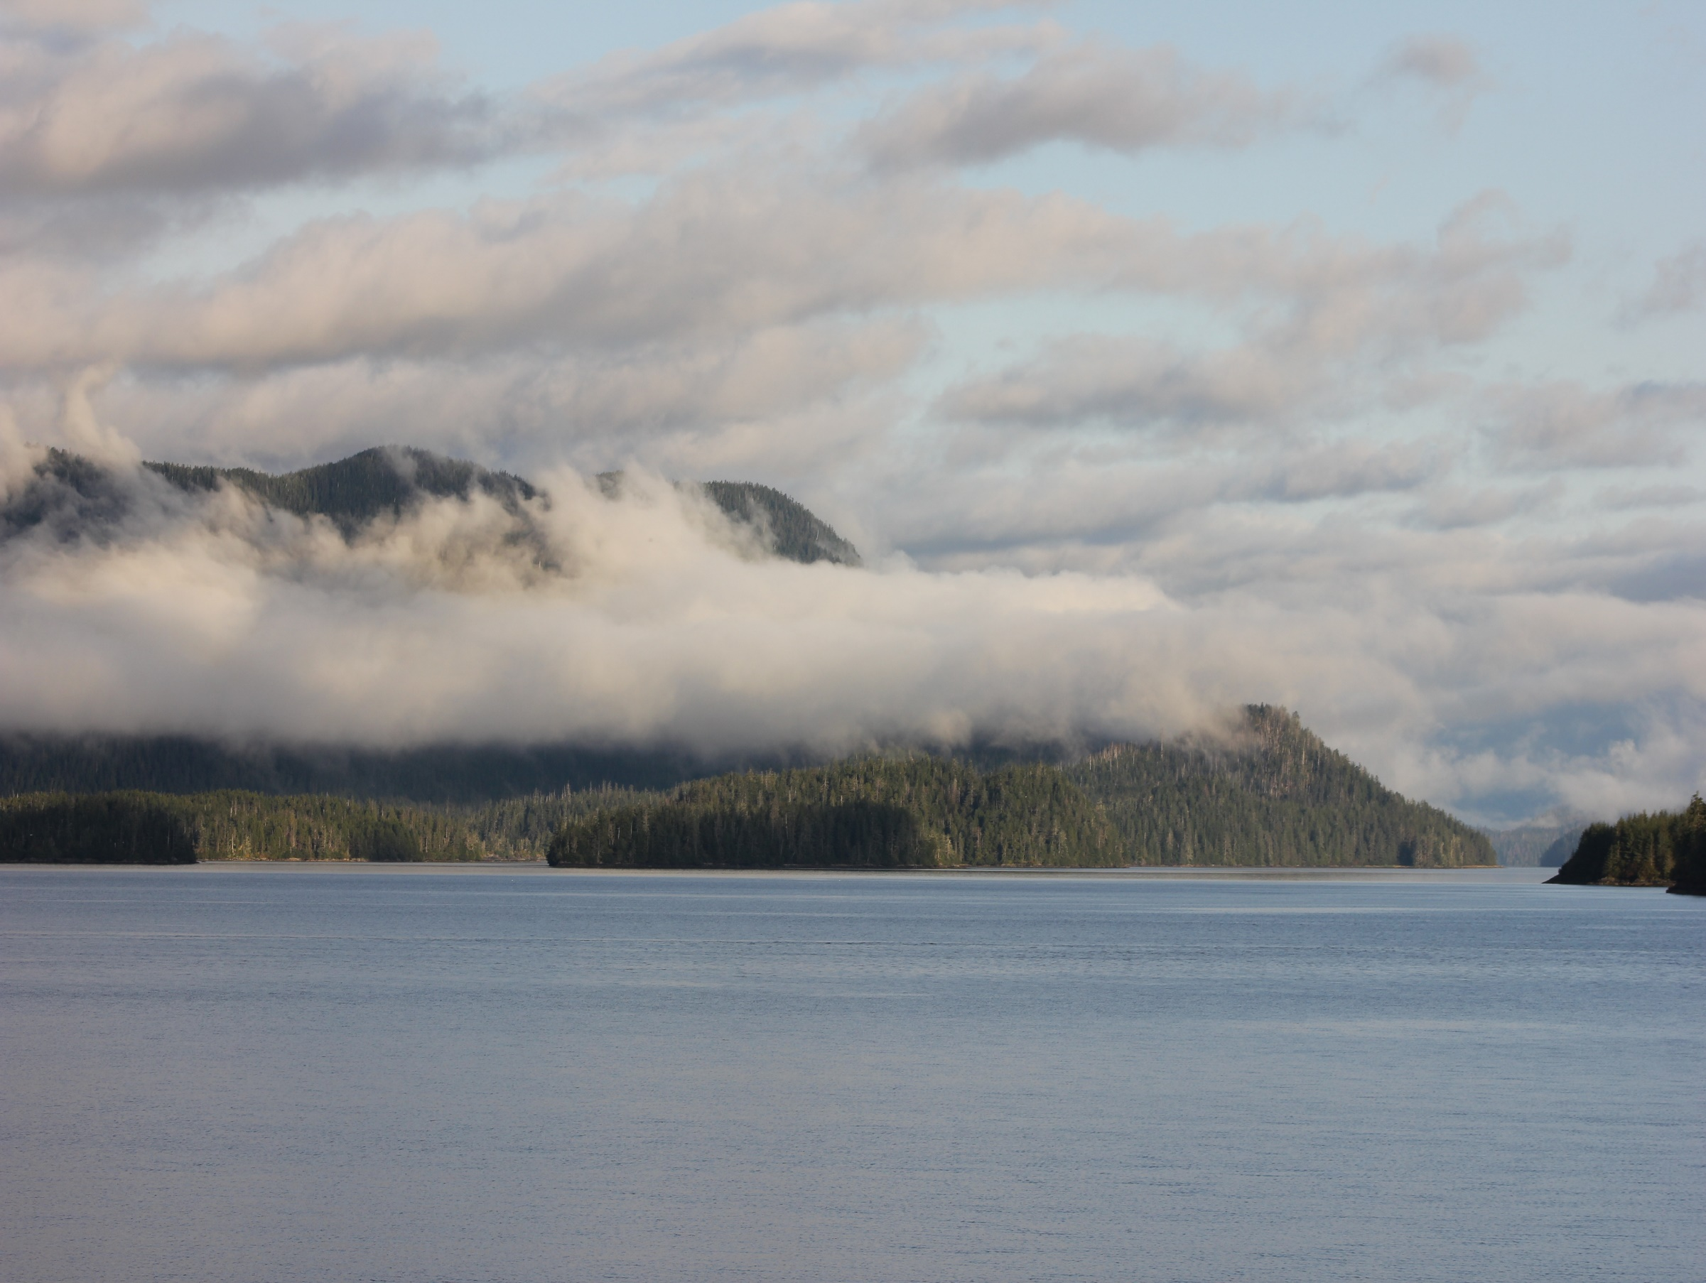
We want to hear from you!
Southeast Conference has released the
Southeast Alaska
Business Climate Survey
This survey tracks the Southeast Alaska business climate as well as COVID-19 impacts to your business. The survey data will be used to focus economic relief efforts moving forward. It is open to all regional businesses, including the self-employed.
Are you a business owner or operator in Southeast Alaska?
If so, this survey is for you!
https://www.surveymonkey.com/r/SEclimate2021

Slide 21
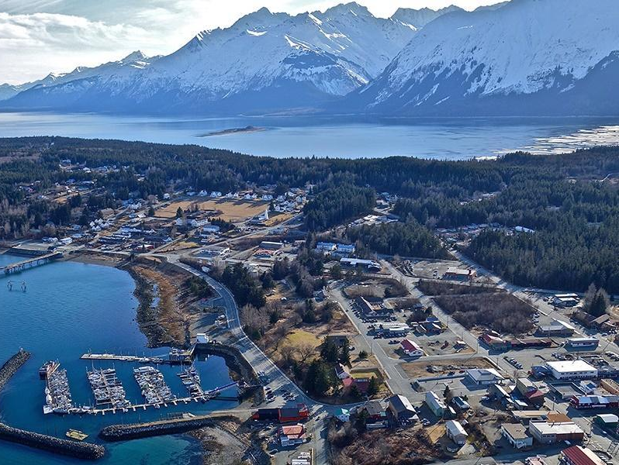
Thank You!
Save the date!
Southeast Conference’s
2021 Annual Meeting
September 14-16
in beautiful Haines, Alaska
Robert Venables
robert@seconference.org 907.586.4360

